Slide 1
Alexander Thamm Summer Event 2014
Michael Hausenblas, Chief Data Engineer
September 2014

Slide 2
Topics
IoT—a superset of the Internet
Categorization & use cases
Business Intelligence and the IoT
Managing Time Series at Scale
MapR’s IoT offering

Slide 3
IoT—a superset of the Internet

Slide 4
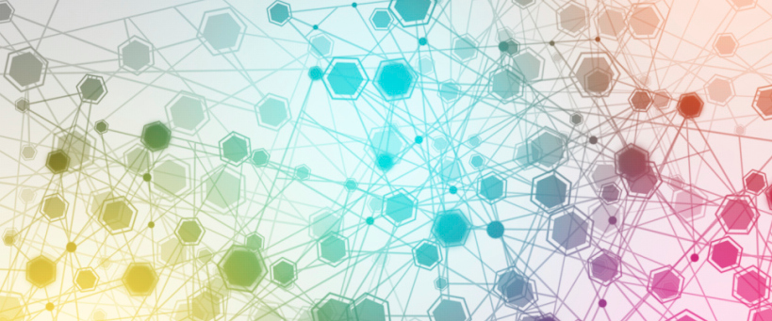
IoT—a superset of the Internet
What is the IoT?
“The idea of an all-encompassing and ubiquitous network of devices to facilitate co-ordination and communication between the devices themselves as well as between the devices and human end-users. The involved devices are typically constrained devices such as RFID sensors, but may also more sophisticated ones like smartphones.”

Slide 5
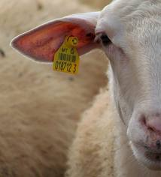
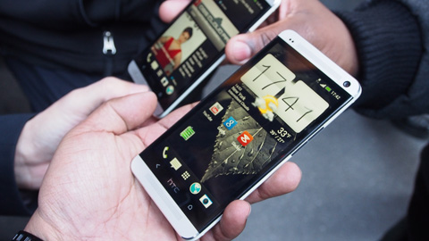

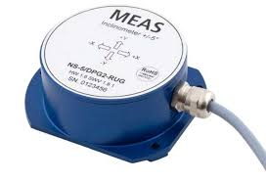
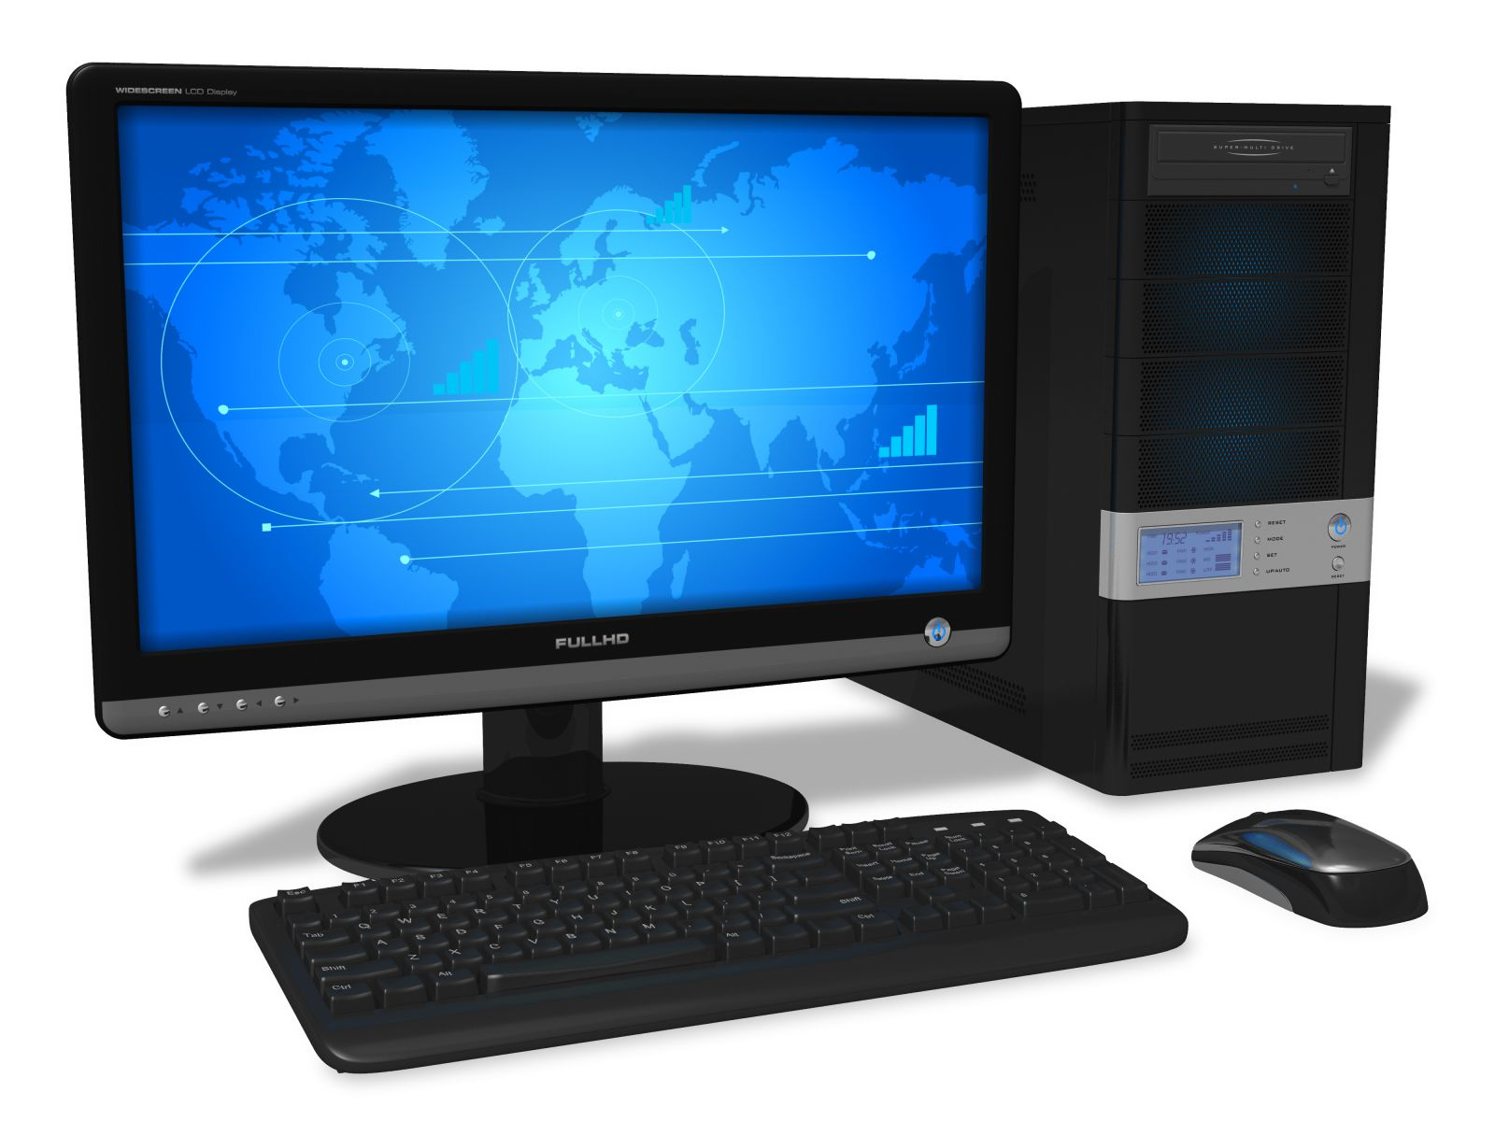
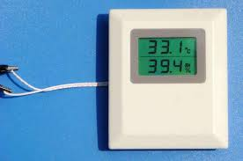
IoT—a superset of the Internet
mobile
thin
fat
stationary
devices and their deployment

Slide 6
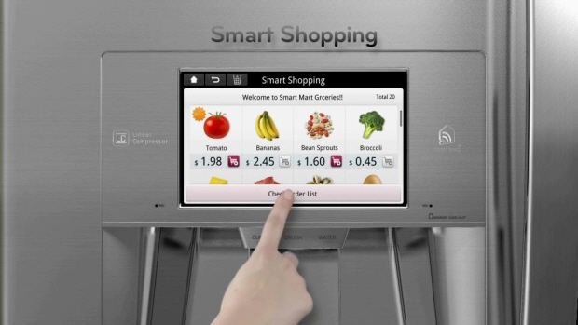
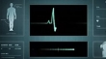
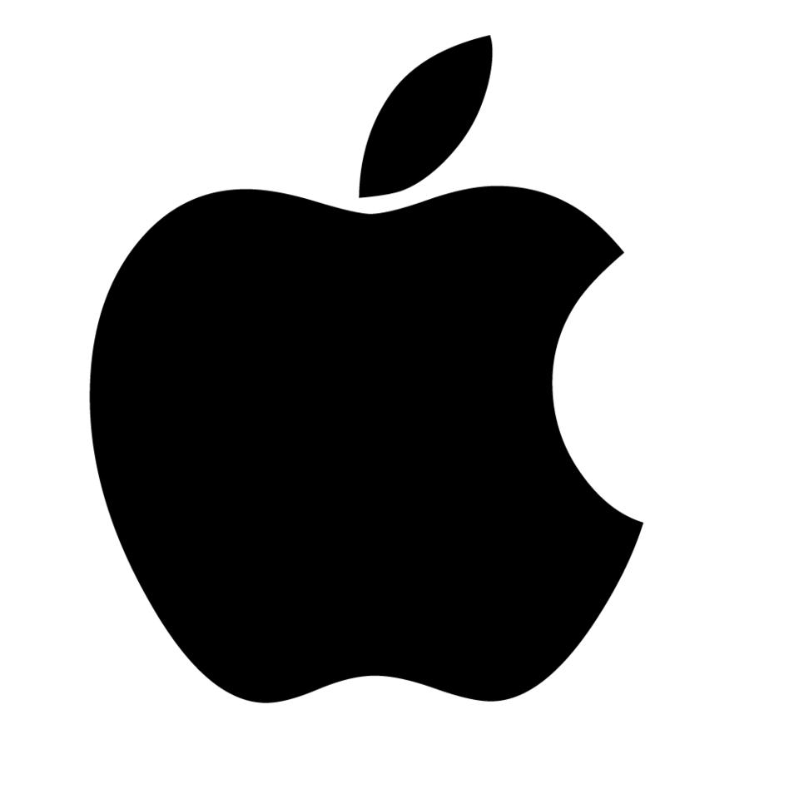
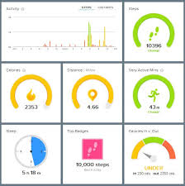




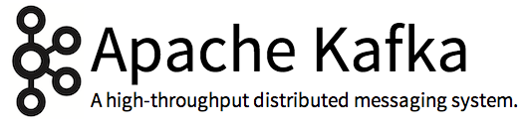
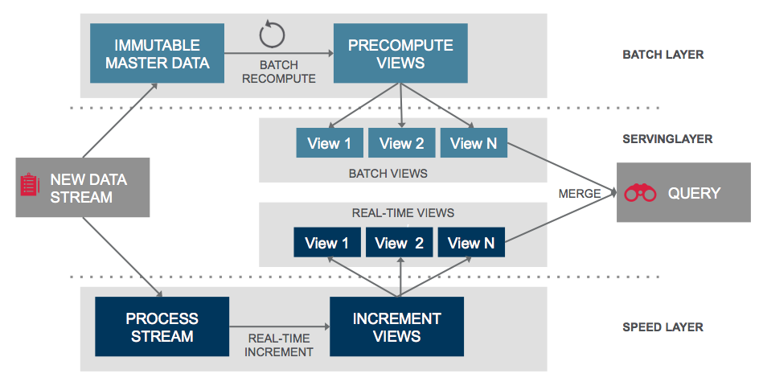
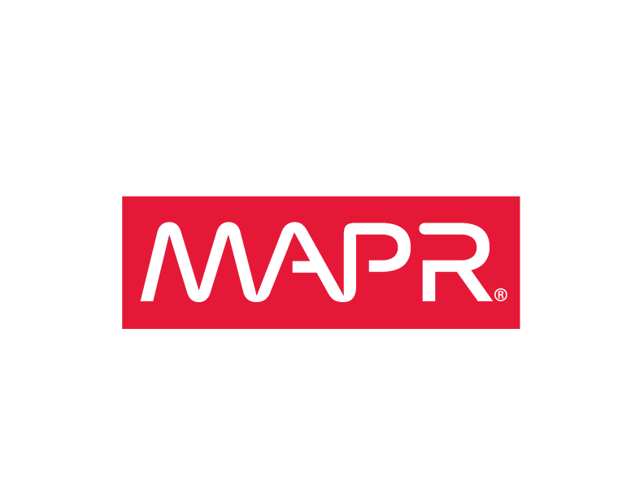


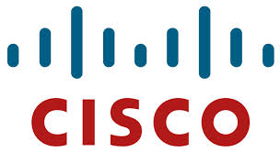

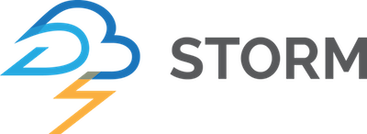
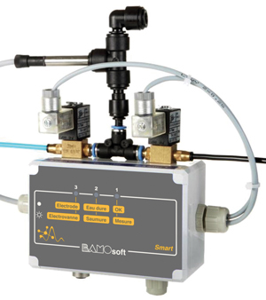
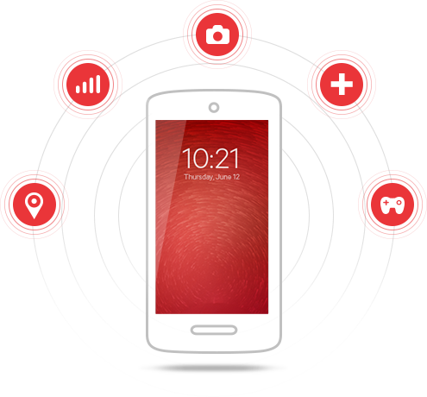
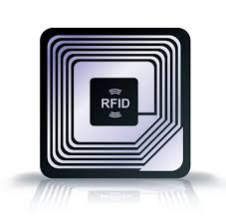


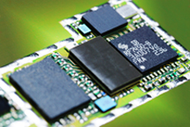

The IoT landscape
apps
data
infrastructure
Notes:
Explains the IoT landscape in terms of (commercial) players and consortia

Slide 7
IoT use case categories and apps

Slide 8
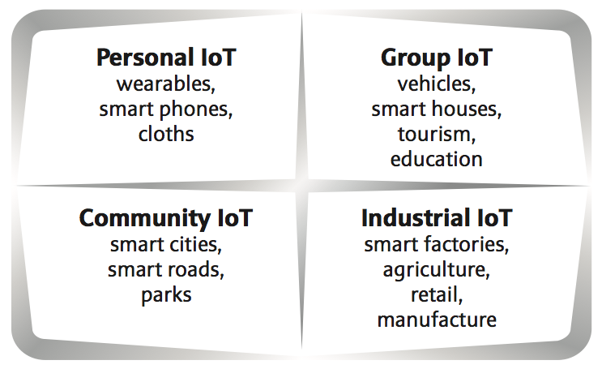
Categorization & use cases

Slide 9
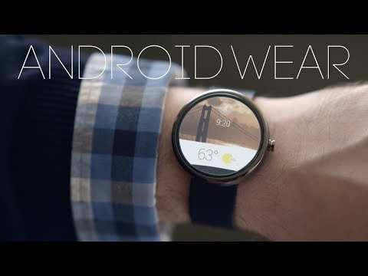
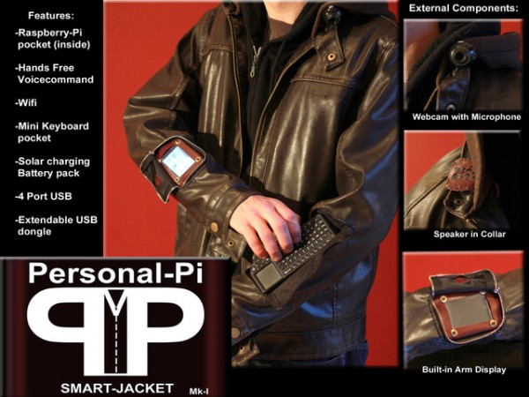
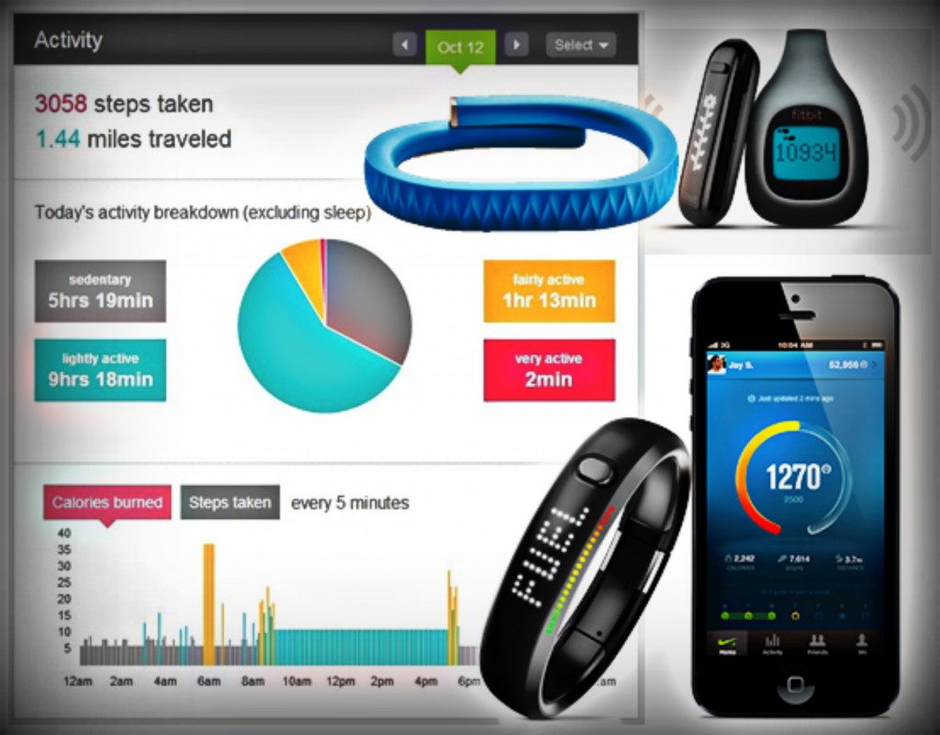
Categorization & use cases: Personal IoT
Scope is on a single person, for example a smartphone equipped with GPS sensor or a fitness device that measures the heart and sharing this data with her GP. One of the fastest growing, rather consumer-oriented areas of IoT.
Use cases and apps
Quantified self
Smart jackets
Personal digital assistant

Slide 10
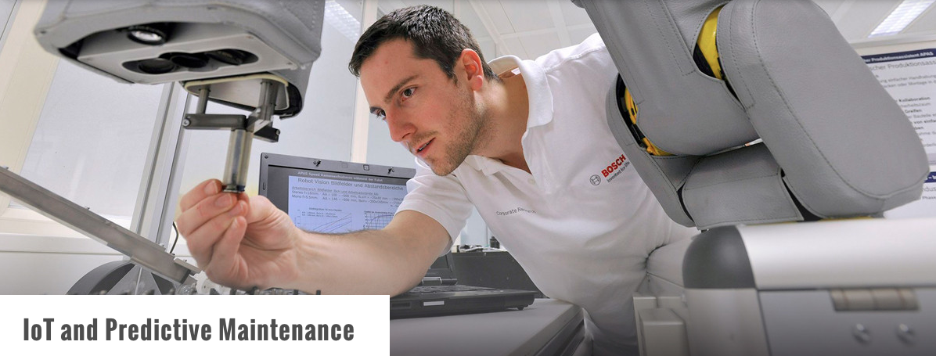
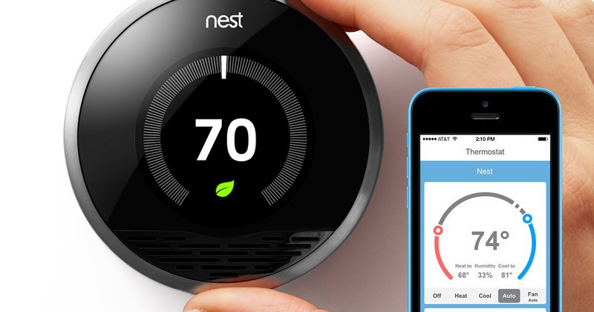
Categorization & use cases: Group IoT
Focuses on a small group of people, for example a family in the context of a smart home where the deployed sensors capture temperature and lighting conditions for optimal comfort. One of the most challenging areas and yet early days.
Use cases and apps
Smart homes
Proactive/predictive car maintenance
Interactive tourism

Slide 11
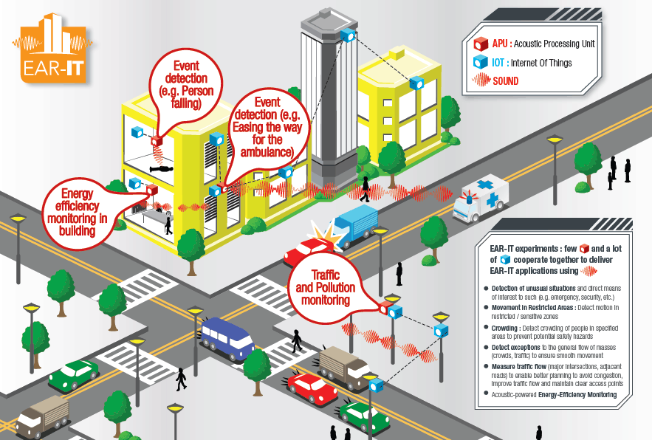
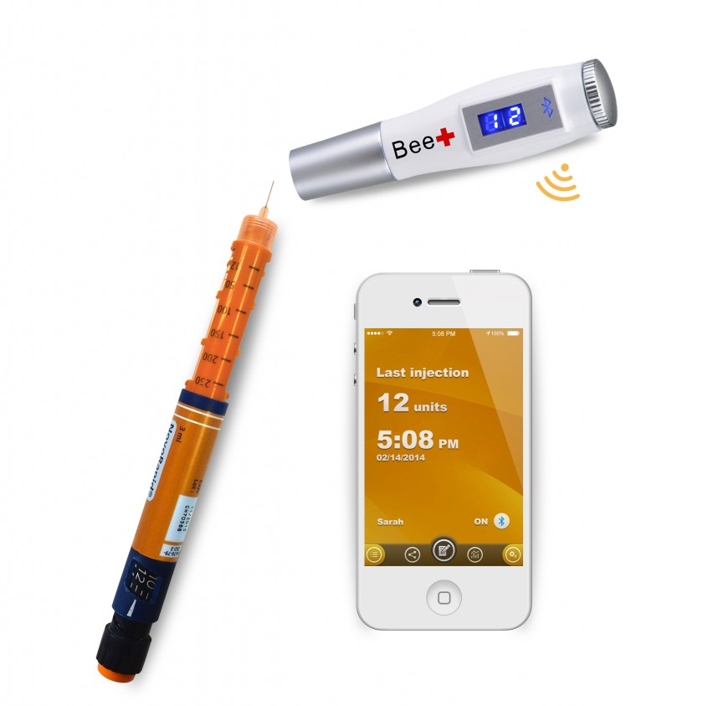
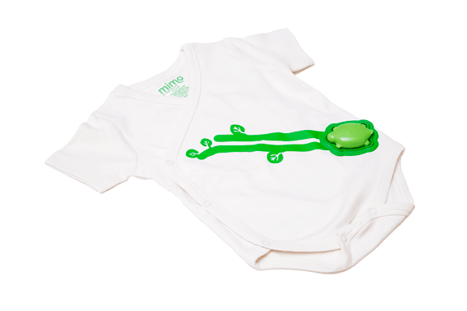
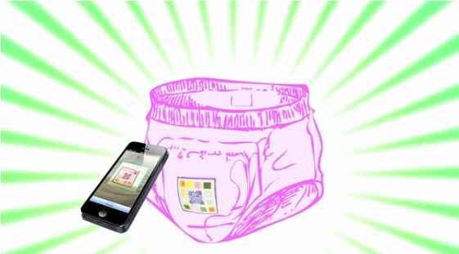
Categorization & use cases: Community IoT
Considers a large group of people, potentially tens of thousands, usually in the context of public infrastructure, such as smart cities. Some immature from a commercial POV but potentially promising IoT area.
Use cases and apps
Smart cities
Health care (monitoring, trackers)

Slide 12
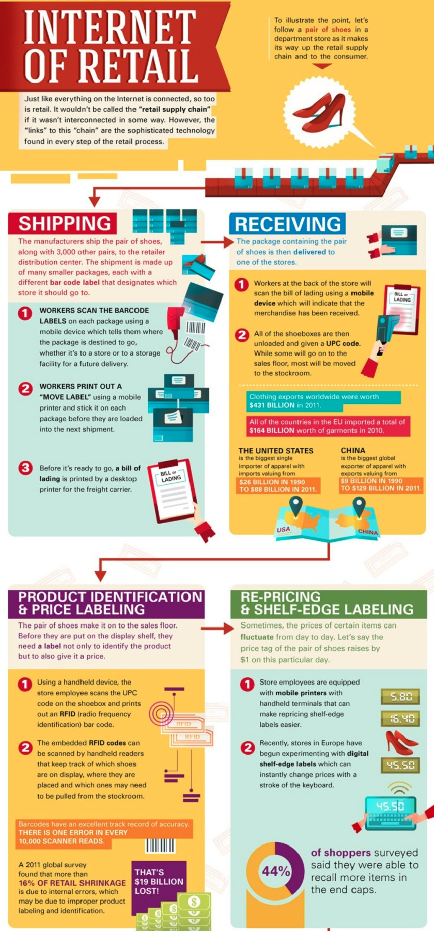
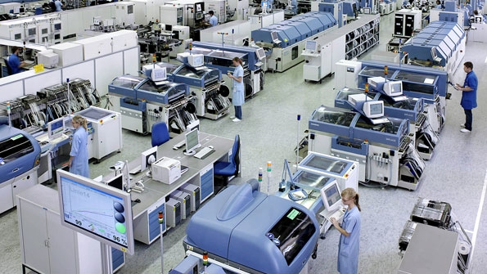
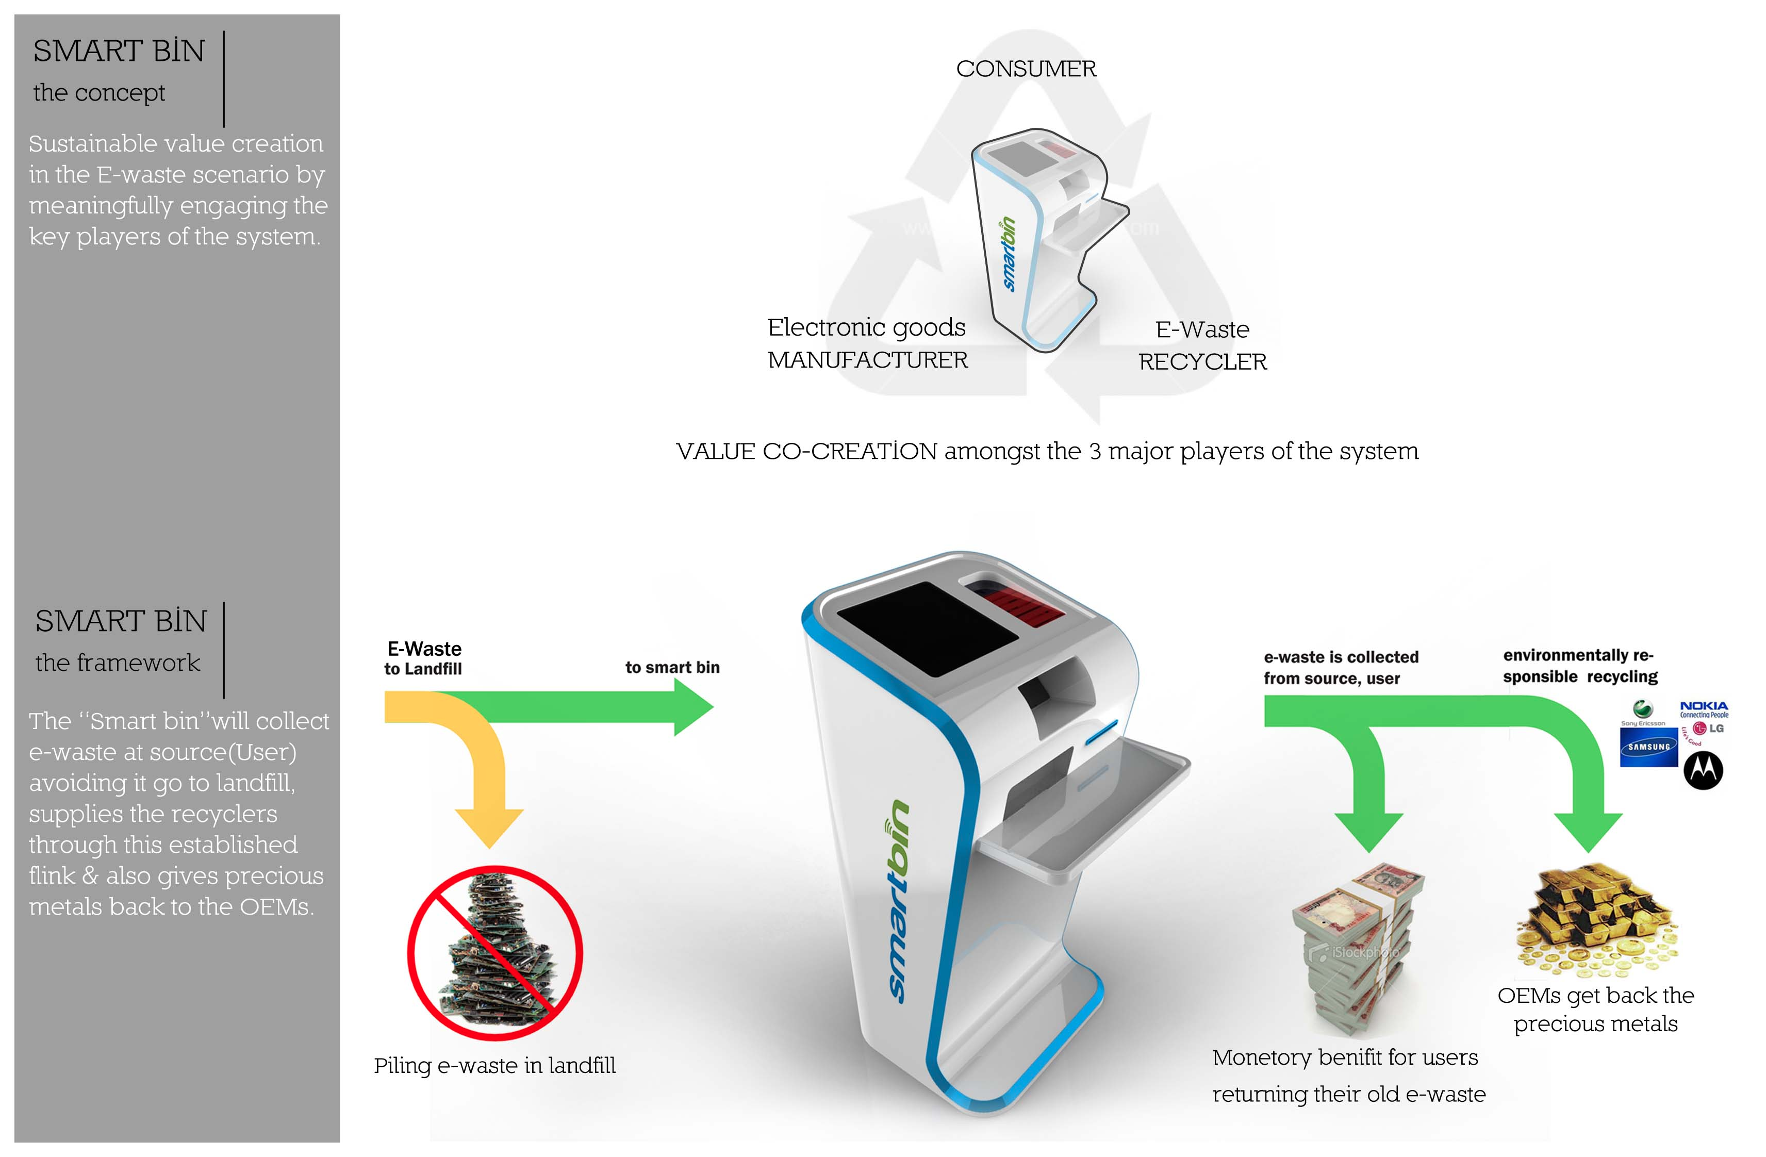
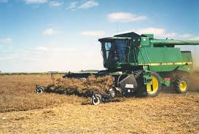
Categorization & use cases: Industrial IoT
Scope can be either within an organization or between organizations and/or individuals. This is arguably the most established and mature part of IoT, see also M2M.
Use cases and apps
Smart factory
Retailer supply chain
Agriculture
Waste management

Slide 13
Business Intelligence and the IoT

Slide 14
What is Business Intelligence (BI)?
Umbrella term for methodologies, architectures, and technologies that transform raw data into meaningful business insights. This includes related activities such as:
data mining*
reporting
online analytical processing (OLAP)
real-time analytics
predictive analytics
*) not covered in the following

Slide 15

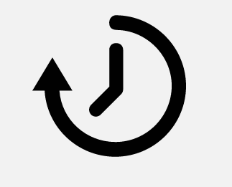
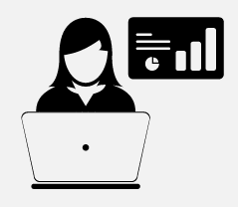
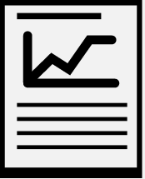
The value of BI
predictive analytics
what might happen?
real-time analytics what and why is it happening, now?
OLAP why did it happen?
reporting what happened?
business value
Notes:
The value increases the more recent, more accurate, more all-encompassing the activity is
For example, it’s good to see in a report that last week you’ve sold 100 articles from a certain category, however it’s much more insightful to have a break-down (in which region? who bought it? which other articles have been bought together with this article?)
Also, for many businesses real-time information about buyers behavior are essential (think: events, auctions, etc.)
Predicting the future is never easy, but providing good enough indicators for humans to take (or avoid) certain actions can make a huge difference to the bottom-line

Slide 16
BI use cases
 |  | example
 | reporting | A summary of the sales per category for last week is automatically generated on Sunday night.
 | OLAP | Business analyst issues ad-hoc query to gain insight about last week’s sales.
 | real-time analytics | Business analyst equipped with real-time metrics on a dashboard monitors impact of marketing campaign (incl. comparison with historical values).
 | predictive analytics | Based on machine learning techniques, products of a certain category are suggested for special marketing campaign (typically with human validation).
Notes:
Note: would be great if we find one or more concrete (public) customer stories as examples for each step

Slide 17
Technologies typically used to realise …
 |  | Back-end | Front-end
 | reporting | Hive, Pig, Spark SQL (Shark) | Excel, Tableau, Datameer
 | OLAP | Hive/HBase/M7 tables + Drill/Impala/Vertica | SAS, QlikView, Tableau, Datameer
 | real-time analytics | Kafka + Storm/Spark Streaming + Hive | DataTorrent, bespoke dashboards (web applications)
 | predictive analytics | Potentially all above + Elasticsearch/Solr Mahout/Spark MLLib | Often bespoke apps
Notes:
Back-end means: the stuff that stores, processes, analyzes, queries, etc. the data
Front-end means: the user-facing stuff, some kind of app (desktop of Web) that either an internal user, such as a business analyst (BA) or an end-user (like you and me) uses. For example, SAS might be used for an BA while we use, for example Salesforce in the browser.

Slide 18
Managing Time Series at Scale

Slide 19
OpenTSDB
OpenTSDB is a distributed Time Series Database build on top of HBase, enabling you …
to store & index, as well as
to query & plot
… metrics at scale.
http://opentsdb.net/
https://github.com/mapr-demos/opentsdb

Slide 20
OpenTSDB: design goals
Distributed storage of metrics
Metrics query fast and easy
Scale out to thousands of machines and billions of data points
No SPOF

Slide 21
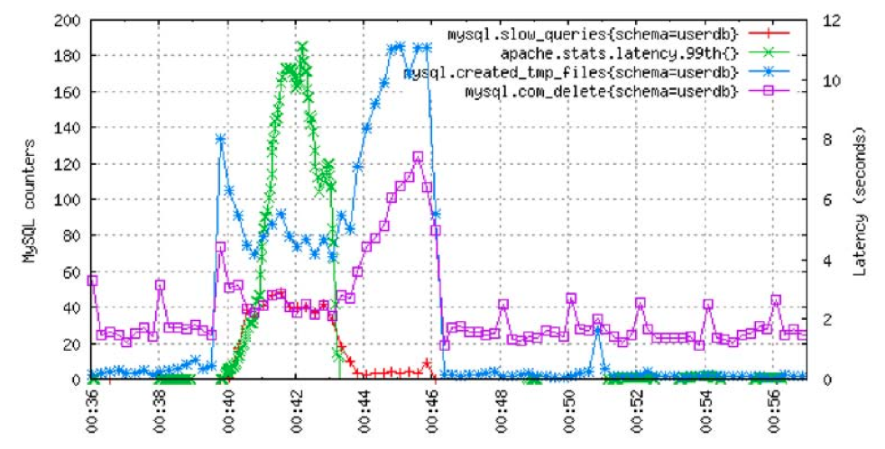
OpenTSDB: key concepts
(00:38, 56)
mysql.com_delete
schema=userdb
data point: (timestamp, value)
+ metric
+ tag: key=value
→ time series

Slide 22
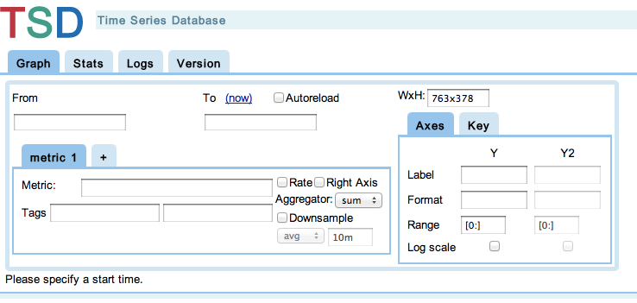
OpenTSDB: high-level architecture
app/metric
write path
read path
$cript (alert, etc.)
tcollector
tcollector
tcollector
TSD RPC
TSD RPC or HTTP
TSD
TSD
TSD
TSD
HBase RPC: PUT, SCAN
HBase
http://opentsdb.net/overview.html

Slide 23
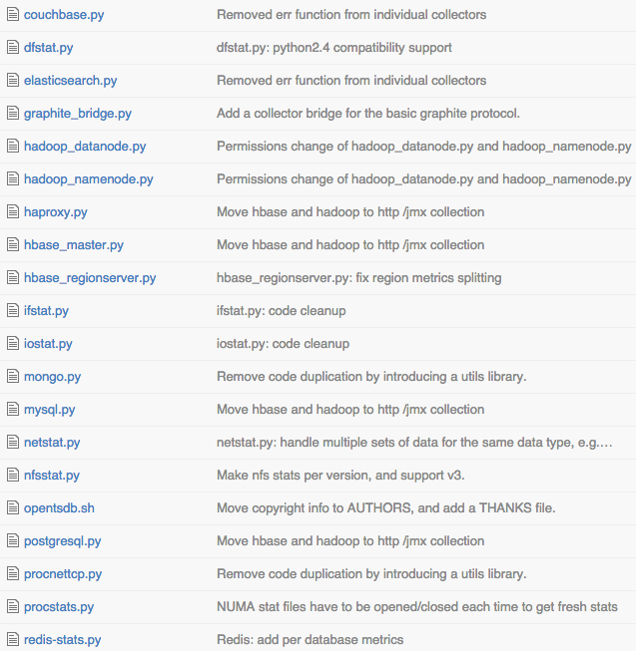
OpenTSDB: collecting metrics
tcollector: gathers data from local collectors, pushes to TSDs and providing deduplication
lots bundled
General: iostat, netstat, etc.
Others: MySQL, HBase, etc.
… or roll your own

Slide 24
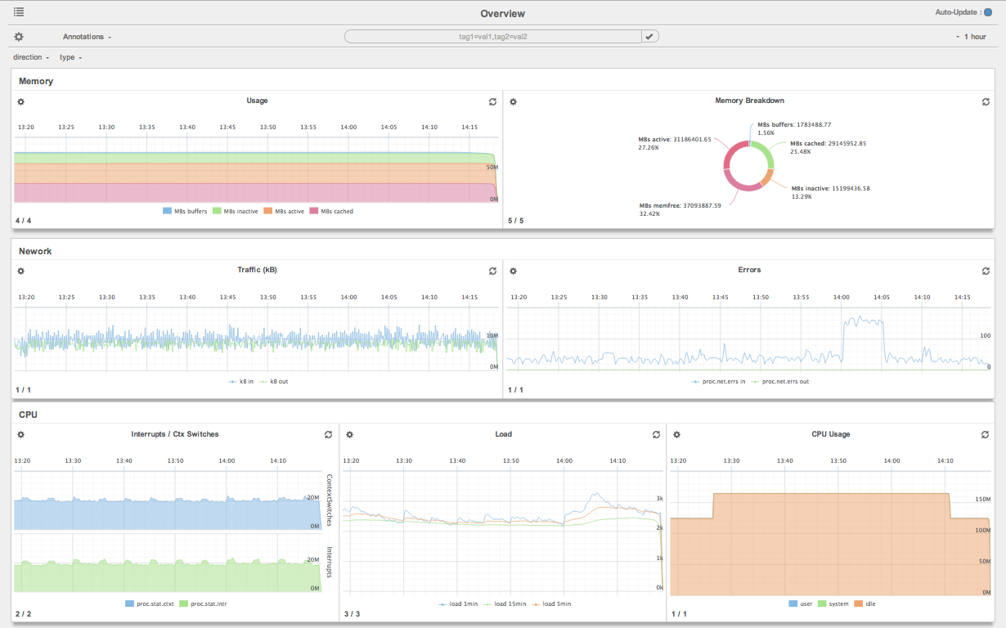
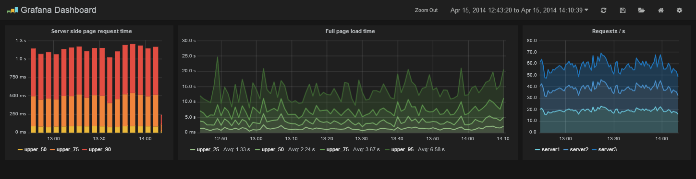
OpenTSDB: interfacing
HTTP API
CLI (tsd, query, mkmetric, etc.)
Java lib: asynchbase
Dashboards (such as Metrilyx or Grafana)

Slide 25
OpenTSDB with MapR (HBase <–> MapR-DB)
message queue
tcollector
MapR-DB
data points
buffering data for 1 hour in collector allows 1000x decrease in insertion rate
web app
users
https://github.com/mapr-demos/opentsdb

Slide 26
Alternative TSDB for smaller scales
InfluxDB (written in Go)
lots of client libs
(cluster support via Raft)
powerful query language
select mean(value), percentile(90, value) as percentile_90
from /^stats.*/
group by time(10m)
into 10m.:series_name

Slide 27
MapR’s IoT offering

Slide 28
MapR’s IoT offering—observations
General observation: IoT lends itself to Big Data approach
An IoT-ready data processing platform must …
… be able to natively deal with the raw data from devices, causing typically many (trillions) of small files in non-relation formats.
… support range of workloads, especially streaming as first-class citizen.
… ensure business continuity to meet SLAs (think: roads, health care, etc.).
… provide for a secure, safe and privacy-aware end-to-end operation
Notes:
IoT naturally lends itself to the ‘Big Data approach’
The data the IoT devices generate lends itself to the Big Data approach. This is, in a nutshell, the idea to run data processing in a scale-out fashion on commodity hardware, using open & community-defined interfaces (such as Hadoop’s MapReduce API) along with openly defined data formats (like Parquet) in a schema-on-read fashion:
Volume. In order to develop a full-blown (commercial) IoT application and maximize the benefits, one needs to be able to capture and store all the incoming sensor data, to build up the historical references. While a single, simple sensor—say, a temperature sensor—might only generate a few MB per year, the overall number of sensors in a typical deployment can put you quickly into the high TB if not PB range of storage demand.
Variety. There are dozens of data formats in use in the IoT world, often binary formats or compressed textual formats (due to the limitations of the devices, in terms of power, storage, bandwidth, etc.). Further, none of the sensor data is relational per se. A data processing platform that allows landing all this data in its raw form is superior compared to an RDBMS and its dependency on ETL.
Velocity. Many devices generate data at a high rate and usually we cope with data streams in an IoT context—both things RDBMSs are not well suited to deal with.

Slide 29

MapR’s IoT offering
APACHE HADOOP AND OSS ECOSYSTEM
Batch
ML, Graph
SQL
NoSQL & Search
Streaming
Data Integration
& Access
Security
Provisioning
&
Coordination
Workflow
& Data Governance
Tez
Spark
Drill
Cascading
GraphX
Spark SQL
Accumulo*
Kafka
Hue
Savannah*
Pig
MLLib
Impala
Solr
Storm
HttpFS
Juju
MapR Control System
(Management and Monitoring)
MapReduce v1 & v2
Mahout
Hive
HBase
Spark Streaming
Flume
Knox*
Falcon*
Whirr
YARN
Sqoop
Sentry*
Oozie
ZooKeeper
EXECUTION ENGINES
DATA GOVERNANCE AND OPERATIONS
NFS
HDFS API
HBase API
JSON API
MapR-FS
(POSIX)
MapR-DB
(High-Performance NoSQL)
MapR Data Platform
(Random Read/Write)
Enterprise Grade
Data Hub
Operational

